Slide 1
®
Welcome to Destination ImagiNation
®
TM
G
© 2003 Massachusetts Destination ImagiNation. All rights reserved.
Notes:
SLIDES 1-3 GIL
SLIDES 4-6 SANJAY
SLIDES 7-9 GIL
SLIDES 10-13 SANJAY
SLIDES 14-19 GIL

Slide 2
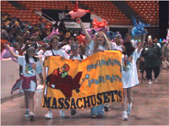
®
®
... Just Imagine
a program where your kids build confidence through learning,
a program where discovery is the only teacher,
a program that builds lifelong learning and problem-solving skills.
G
Video

Slide 3
Overview
What is Destination ImagiNation®?
Philosophy and goals
Who we are (local, state and international volunteers)
Program structure
Who is eligible
A typical year
Parents’ roles
Reasons to be a Destination ImagiNation® Team Manager
G
Who we are, why we do it, and why the kids have fun!

Slide 4
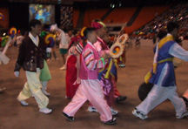
Destination ImagiNation® is . . .
a non-profit corporation supported by International Affiliates throughout the world who work together to offer the world’s largest kid-powered & team-driven creative problem-solving program
S
...in which the kids have fun, and learn without realizing it!

Slide 5
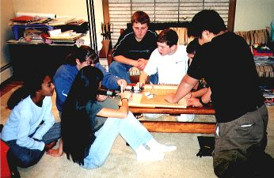
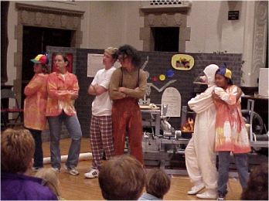
Destination ImagiNation® teaches...
Creative problem-solving
Teamwork to solve a complex challenge
No single answer (open-ended Challenges)
Balance time, budget, creative ideas
Presentation skills
All in a supportive environment where all ideas are team-generated so that team members have ownership of the solution.
S
Total Team-generated Solution without adult “interference”

Slide 6
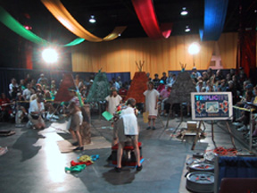
Destination ImagiNation® Program Structure
Teams form in the fall (5-7 participants)
Throughout the program year, they work as a team to solve a Team Challenge as well as learn the techniques of brainstorming and instant problem-solving through Instant Challenges and the use of Improv items
What they learn during this process are the tangible rewards of the program
Culmination of their work is showcased at Destination ImagiNation® tournaments
Regional Tournaments,
State Tournaments, and
Destination ImagiNation® Global Finals
G
Tournaments are incredible expositions of the team’s creativity

Slide 7
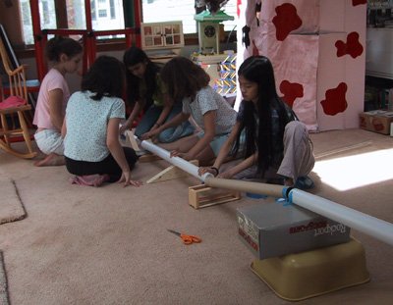
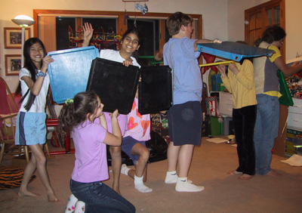
Destination ImagiNation® Program - Instant Challenge
Instant Challenges teach participants to take what life is handing them moment to moment. These Challenges spark and quickly capture the team members’ wild imaginations by requiring them to solve a challenge quickly and decisively.
G
Video
Instant Challenges teach our kids to think quickly with confidence

Slide 8
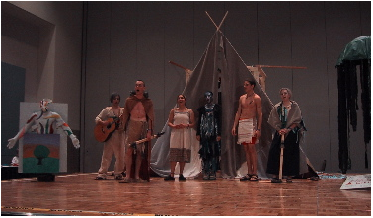
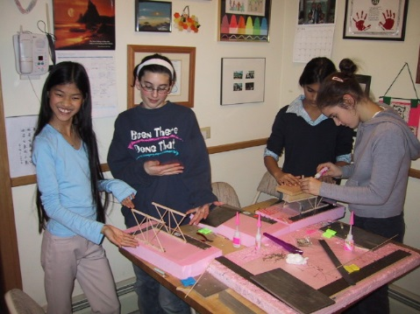
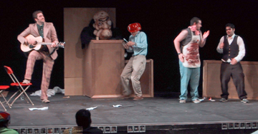
Destination ImagiNation® Program - Team Challenge
Teams use art, technology and performance as they tackle one of the five Team Challenges. The Team Challenge solution can take from several weeks to several months to develop.
The teams must do the research and experimentation needed to solve every aspect of the Team Challenge and develop a performance-based presentation demonstrating the team’s solution.
G
Teams work together to solve complex problems

Slide 9
Team Challenge
THE CHALLENGES
There are seven new Challenges to choose from each year
Each of the Challenges is developed by a team of educators and subject matter experts
G
Video

Slide 10
The Interference Rule
SOLUTION
SKILLS
RULES
S

Slide 11
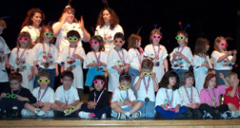
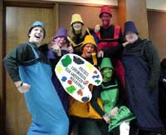
Participant Eligibility
Pre-school thru College
Participants compete in 5 age-based or grade-based levels:
Rising Stars!™ (Ages 4-7),
Elementary (1st to 5th grade),
Middle (6th to 8th Grade),
Secondary (High School),
University
S
No formal academic requirements

Slide 12
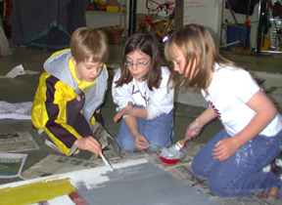
What’s Expected of Participants
Must be willing to work as part of a team
Listen, evaluate and build upon teammates’ ideas
Ability to compromise
Constructing & refining solutions
Presenting solutions
Stay positive with teammates
S
Teamwork teaches Leadership and Compromise

Slide 13
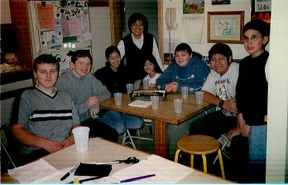
Destination ImagiNation® Typical Year
Team building exercises
Understanding the Team Challenge
Brainstorming of solutions
Working, refining, and more refining
Technical elements, props, costumes, script...
Lots of practice for Instant Challenges
Local trips for junk and supplies
Practice dry-run (school presentation)
Tournament time – March
S
And lots of snacks

Slide 14
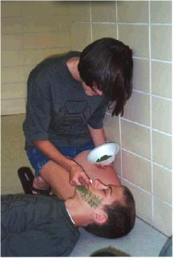
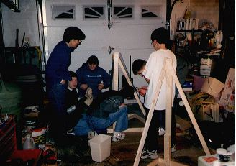
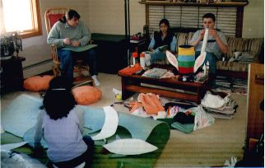
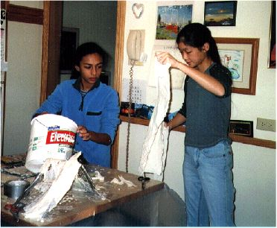
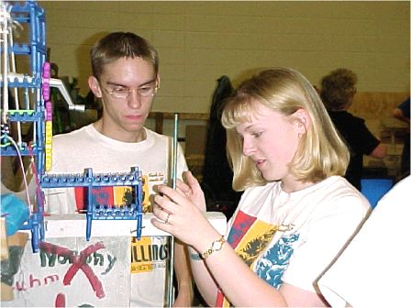
Skill Development
Teamwork
Cooperation
Collaboration
Time management
Communication
Set Design
Power tools
Costume & make-up
S
Lifelong skills

Slide 15
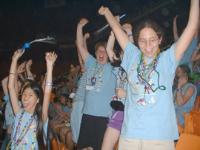
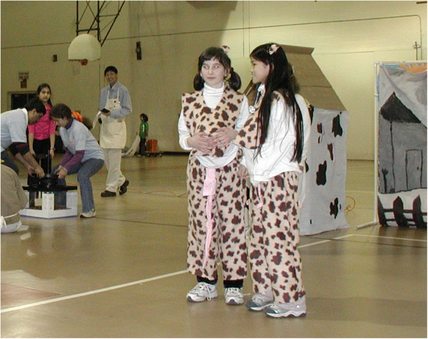
Rough Schedule
Teams
Form
Regional
Tournament
March
STATE
Tournament*
April 1
Teams
Start
GLOBAL
FINALS
SEPT
OCT
NOV
DEC
JAN
FEB
MAR
APR
MAY
Learning to work as a team
Instant Challenges
Understanding the Team Challenge
* Top teams
advance
Brainstorming ideas
Research & experimentation
Creating the presentation
More Instant Challenges
Finalizing, refining solutions
Props, artwork, costumes, scripts
“Crunch” time, rehearse
And more Instant Challenges
G
Time flies when you’re having fun

Slide 16
Team Formation
If we had a magic wand, each team would:
Want to meet at the same time
Be the same age
Be all one gender or an equal mix of boys and girls
We try to come as close to this magic as possible.

Slide 17
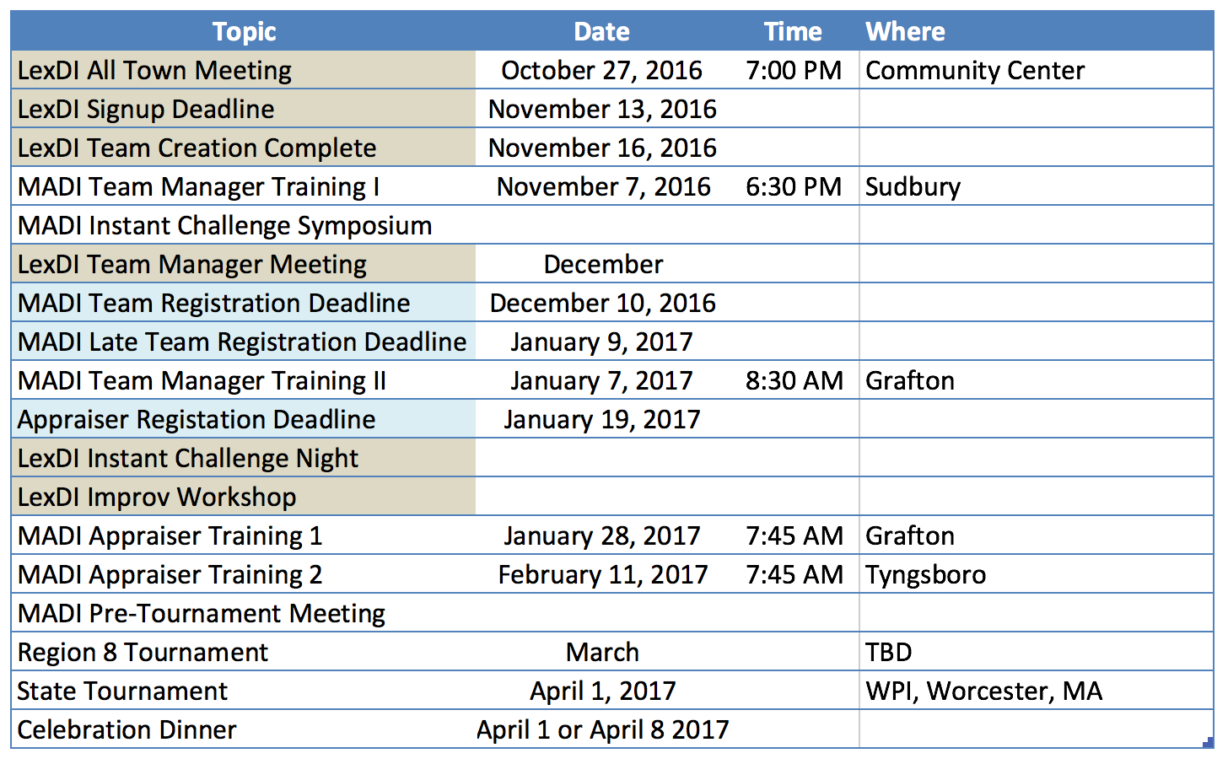
G

Slide 18
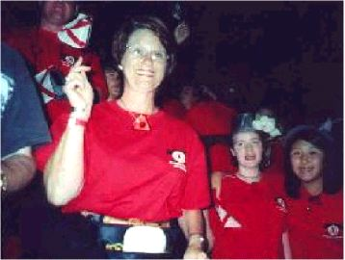
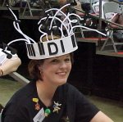
Volunteer/Parent Roles
Team Manager/Assistant
Most rewarding role
Tournament Officials & Volunteers
All levels of competition (Appraiser)
Workshops
Parent helper
Snacks, errands, field trips
Transporting/storing props
Skill presentations
Support your children and the Program
G
Volunteers make this program possible

Slide 19
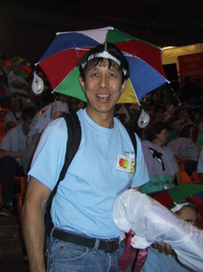
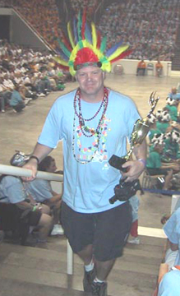
Ten Reasons to be a Destination ImagiNation® Team Manager
Minimal qualifications (can you spell DI™?).
Party conversations become a breeze…you’ll always have an answer to “What’s new with you?”
Keeping up with your team keeps you forever young (…or gives your hair those distinguished silver highlights).
“Destination ImagiNation® Team Manager” looks good on resume.
“No Interference” rule means “It’s not your job to solve the Challenge”.
Team managing expands your shopping horizons… hardware stores take on a whole new look.
You have the opportunity to travel with lots of children to exotic locations … by van and bus.
Destination ImagiNation® expands your stockpile of useful junk.
Team materials hide nasty scratches on your dining table.
Destination ImagiNation® cures the mid-winter blues. Time flies when you’re having fun!
G
Only with volunteer Team Managers, can there be teams

Slide 20
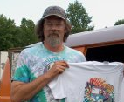
Bonus Reasons to be a Destination ImagiNation® Team Manager
Opportunity to teach real-world life-long skills to a bunch of kids you’ll learn to love.
The satisfaction of seeing a bunch of disorganized kids come together as a team to create a unique solution that they can be proud of.
They’ll rub off on you, and you’ll be more creative as well.
G
You can have a tremendous impact on a great bunch of kids

Slide 21
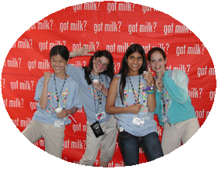
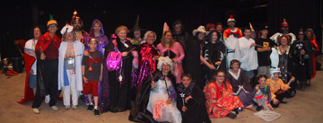
®
“Imagination is more important than
knowledge.
Knowledge is limited.
Imagination encircles the world!”
-Albert Einstein
Destination ImagiNation ®
International Sponsor
G

Slide 22
For updated information:
lexdi.org
&
https://www.facebook.com/LexingtonDI/

